Slide 1

Weather And Boating
Chapter
12

Slide 2
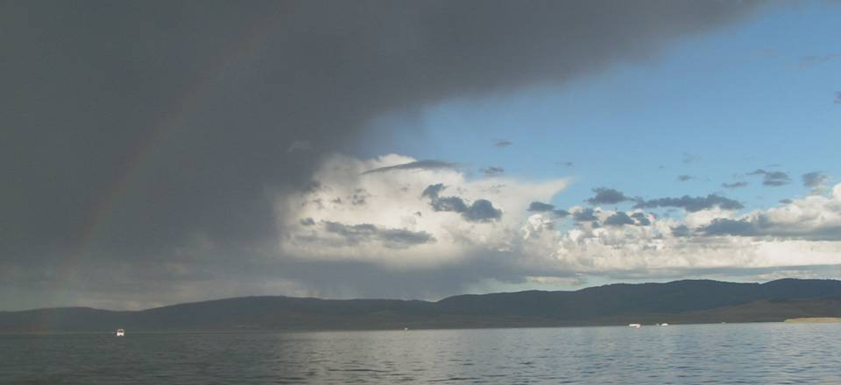
Weather And Boating
Chapter
12

Slide 3

Lesson Objectives
Weather information sources
Basic storm patterns
Storm forecasting and precautions
Go/No Go decision making
Personal weather check list

Slide 4
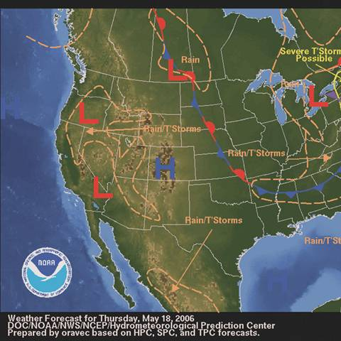
Weather Information
NOAA/NWS
  Surface Analysis
  Interactive
  Weather buoys
  US Winds
  Jet Stream
AccuWeather
Intellicast
Weather Underground
Local cams

Slide 5
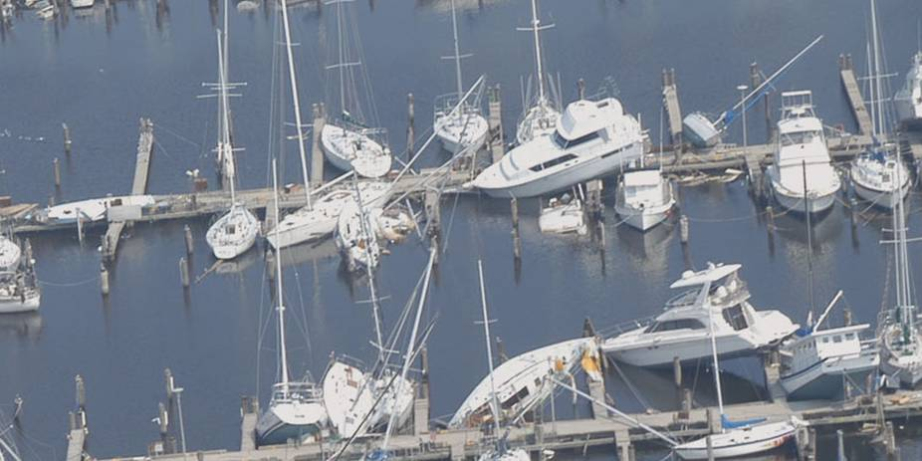
Wind and Boating

Slide 6
Winds and Boats
What are the factors affecting winds?
High and low pressure systems
  Fronts – the intersections of air masses
    Warm – usually clouds & rain, but little wind
    Cold – often mean dramatic wind shifts, strong gusts, storms
    This is where most severe weather occurs
  Heat – buildup of heat over the earth causes air to rise, water condenses as rain
  Land breeze/sea breeze – caused by heat differential between land & sea

Slide 7
Winds and Waves
What are factors that determine characteristics of waves?
  Wind strength
  Fetch - distance over water that wind travels
  Deep water - larger, longer waves
  Shallow water - short, steep waves
  Current - wind against current means short, steep waves
Copyright Hal Roth, 2006, reprinted with permission

Slide 8
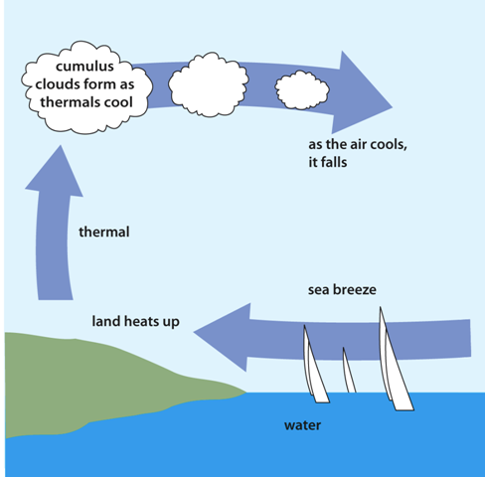
Understanding Weather
Weather and heat
Land and sea breezes
Reprinted with permission from
Gary Jobson’s Championship Sailing by Gary Jobson

Slide 9
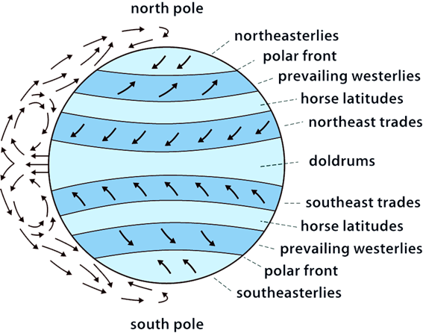
Understanding Weather
Earth’s major wind patterns:
What major wind pattern are we in?
These patterns shift with the seasons and are only general in nature

Slide 10
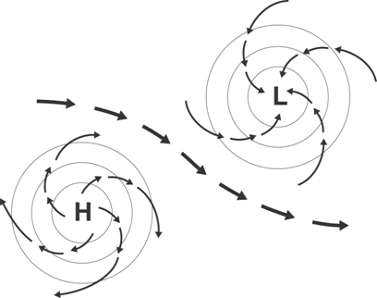
Understanding Weather
Low pressure systems rotate counterclockwise (in N Hemisphere)
High pressure systems rotate clockwise (in N Hemisphere)

Slide 11
Understanding Weather
Low pressure systems often produce inclement weather
  Dramatic wind shifts
  High winds/thundersotrms
  Waves
High pressure systems are associated with fair weather

Slide 12
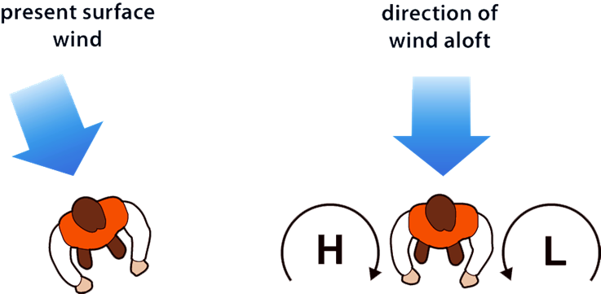
Understanding Weather
Buys Ballot’s Law

Slide 13
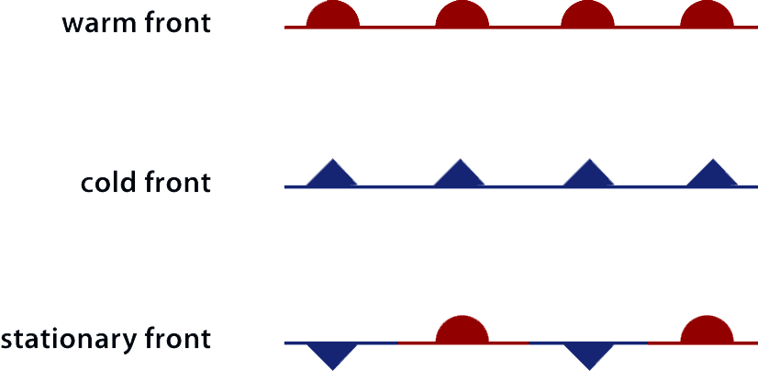
Understanding Weather
Front Symbols
  Warm front
  Cold front
  Stationary front
warm front
cold front
stationary front

Slide 14
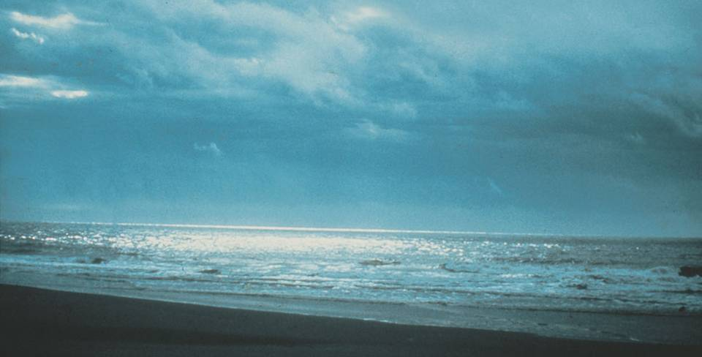
Types of Clouds
Three types of clouds:
  High Level – Cirrus, Cirrocumulous, Cirrostratus
  Mid Level – Altocumulus, Altostratus
  Low Level – Stratus, Stratocumulus, Cumulus, Nimbostratus, Cumulonimbus

Slide 15

Understanding Weather
Weather clues from clouds
  Cold fronts often begin with cirrus clouds, followed by lowering altostratus, then cumulus and cumulonimbus (thunderheads)
  Frontal passage brings wind shift SW to NW, (sometimes strong and sudden)
  Warm fronts are usually preceded by mid-level clouds, lowering to low level stratus, with rain

Slide 16

Understanding Weather

Slide 17
Understanding Weather
Approaching low
Approaching warm front
Passing warm front
Within warm sector
Approaching cold front
Passing cold front

Slide 18
Student Activity
Clouds associated with fronts
Cirrus
Stratus
Cumulus
1
2
3

Slide 19
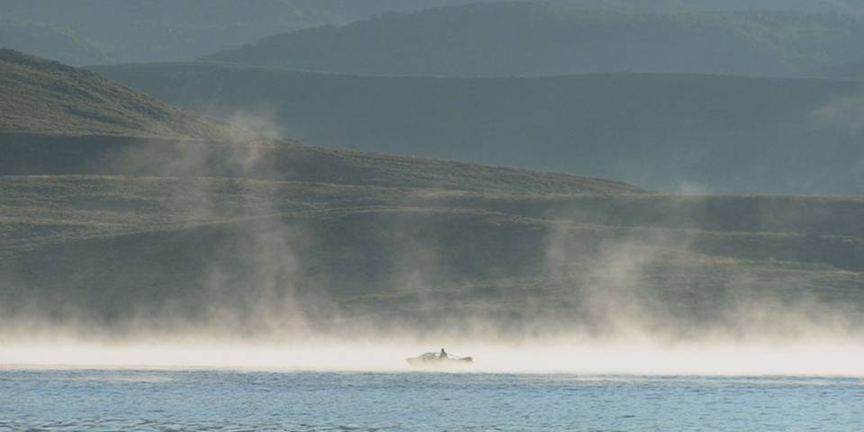
Restricted Visibility
Fog—a cloud on the earth’s surface
    Advection fog - Warm moist air over cold water
    Radiation fog – moist air over cooling land-may extend out to sea
    Frost smoke - very cold air over warm water
Smog – A combination of atmospheric pollution and condensed moisture
Haze – Combination of dust particles, atmospheric moisture, smoke

Slide 20
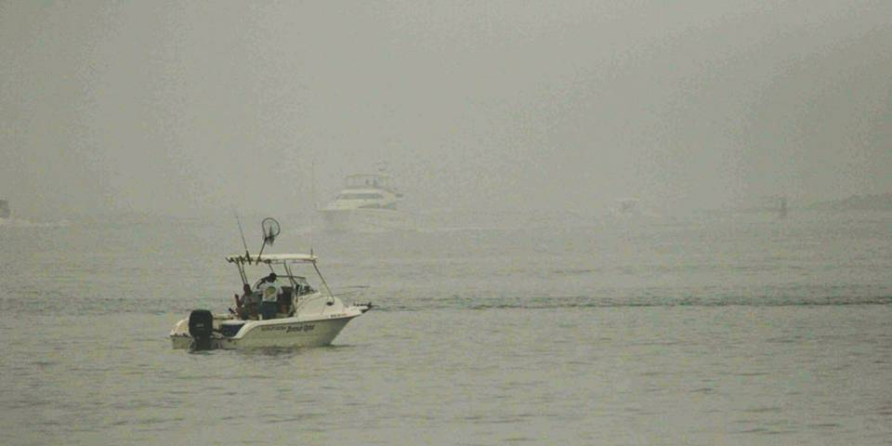
Fog Precautions
Precautions must be taken in fog
  Slow down!
  Keep careful lookout
  Listen to radio
  Use radar
  Use chart
  Navigate!

Slide 21
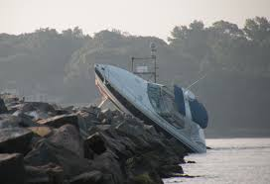
Should have slowed down…
Adapted from Boater’s Bowditch by Rickard K. Hubbard

Slide 22
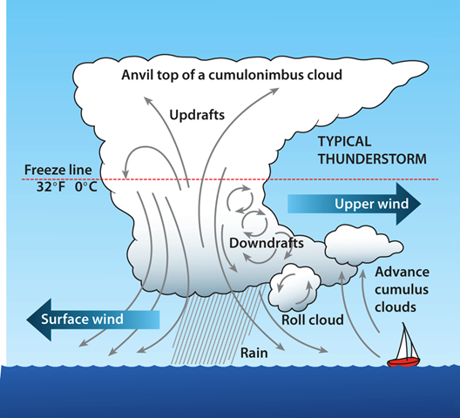
Non-Frontal Weather
Thunderstorms
Can be dangerous
High winds, rapid shifts
Waves can develop rapidly
May presage cold front
May pass quickly and harmlessly
May form waterspouts
Reprinted with permission from
Boater’s Bowditch by Richard K. Hubbard

Slide 23
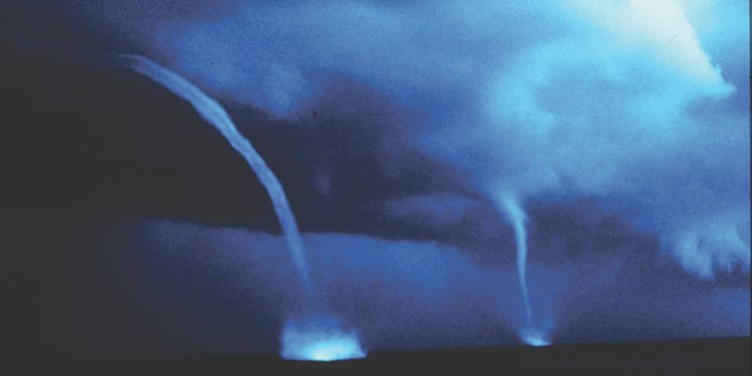
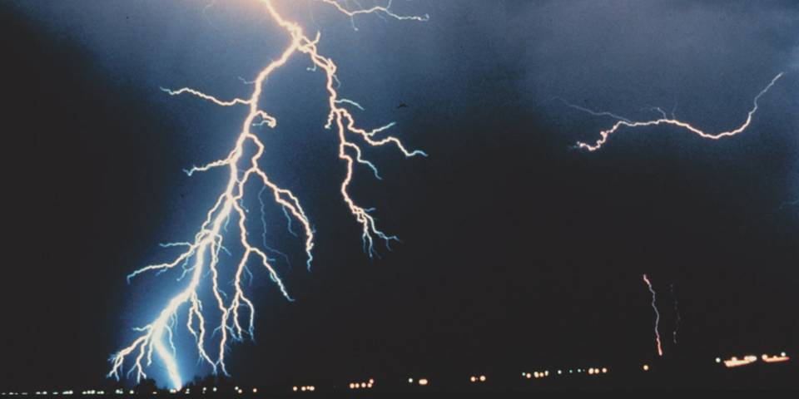
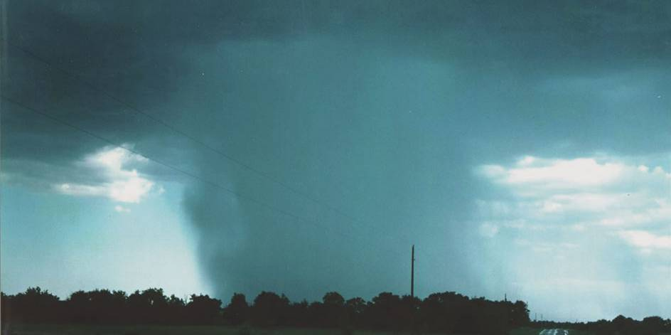
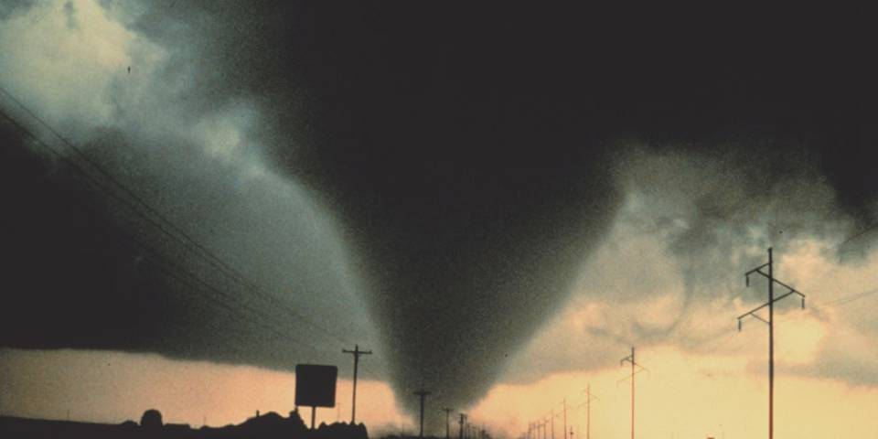
Thunderstorms
Waterspout
  Tornado over the water
  Usually short-lived
  Dangerous if you’re too close
Tornadoes
Lightening
Microbursts

Slide 24
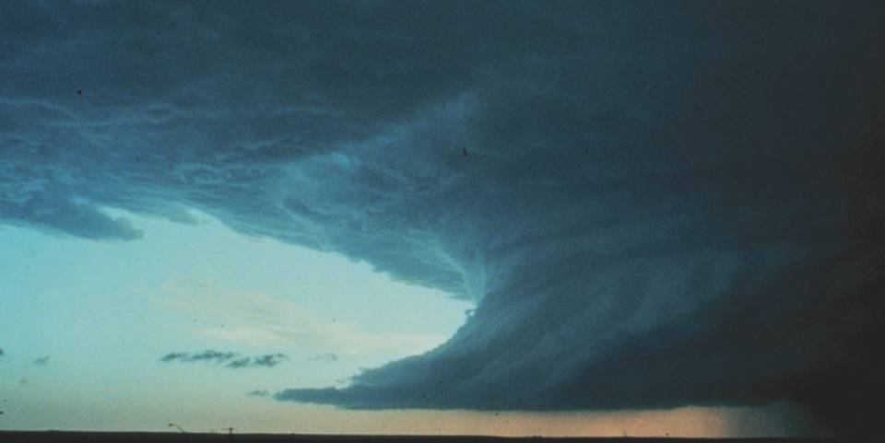
Non-Frontal Weather
If you are caught in a thunderstorm
Have each person don a life jacket
Pin point your location
Keep a sharp lookout
Reduce speed
Head into the wind and 45° to waves
Secure hatches and ports
Stow all gear
Stay low in the boat
Keep away from metal objects

Slide 25
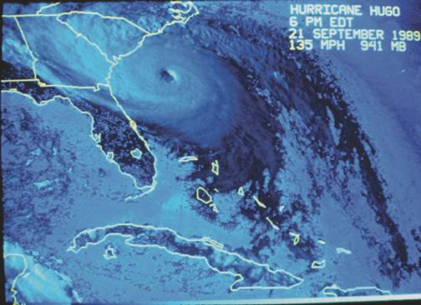
Non-Frontal Weather
Tropical Storms
  Tropical wave or depression
  Tropical Cyclone
  Hurricane

Slide 26
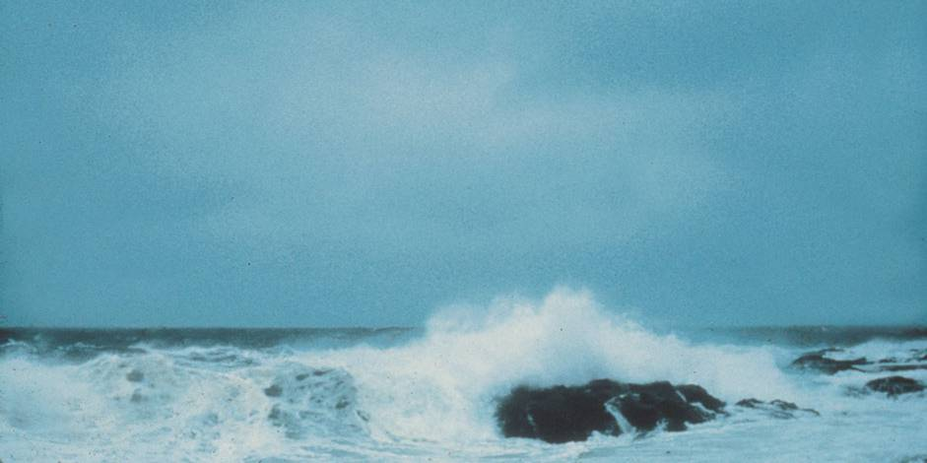
The Go/No-Go Decision

Slide 27

Thank you
Illustrations provided by McGraw Hill Education
The

